Slide 1
The Battle of Neighborhoods
Saint Louis by Demography

Slide 2
Overview
Introduction
Data Description
Methodology
Results and Discussion

Slide 3
Introduction
The Saint Louis Metro City neighborhoods are grouped as North, Central and South Corridors. It is familiar to STLcians that North corridor is predominantly Black while South corridor is predominantly White. The business problem here is to find what is the most common venues among the Black neighborhoods and see if this is different in White neighborhoods.
This could be interest to anyone who is curious about STL and its neighborhoods.

Slide 4
Data Description
01
We will use public data available in Wikipedia to get demographic data about STL neighborhoods and then Foursquare API to get venues in those neighborhoods
02
We will also use Foursquare API to get data about venues in STL neighborhoods.

Slide 5
Methodology
Gather Data
04
Explore & Analyze
Use pandas.read_html to scrape STL neighborhood data with demography and add lat/lon using Nominatim geocoder. Also, use Foursquare API to get venues./
Check cluster features, contrast between neighborhoods and see what are the most common venues.
01
03
Cluster & Visualize
Conclusion
Cluster the neighborhood and visualize corridors using seaborn and create map using folium.
Summarize the findings
02

Slide 6

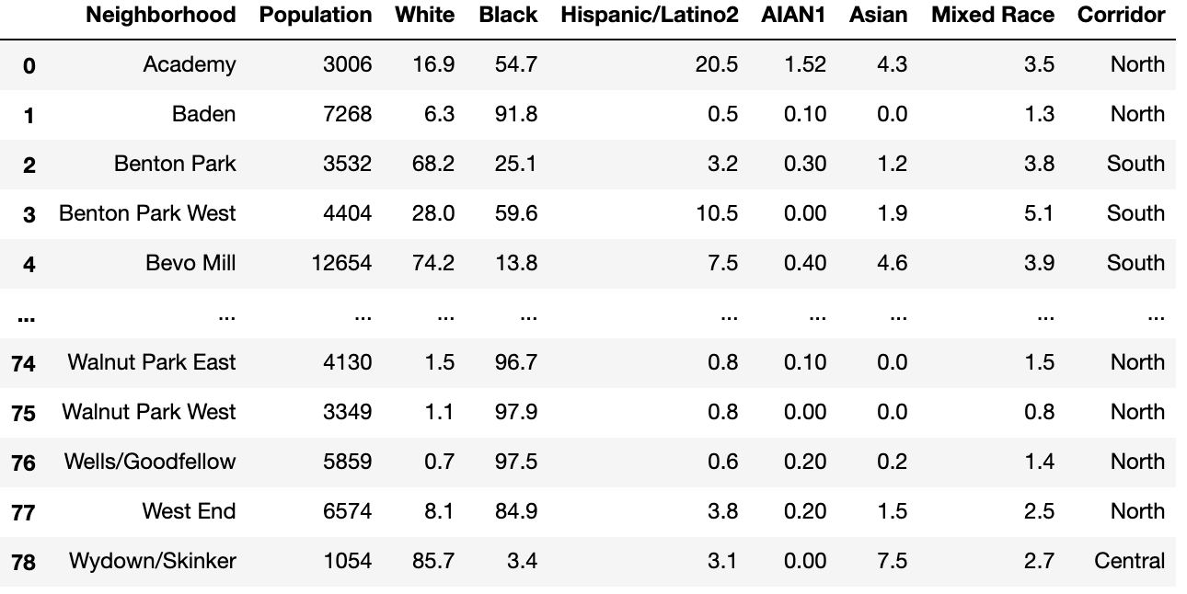


STL Neighborhoods

Slide 7
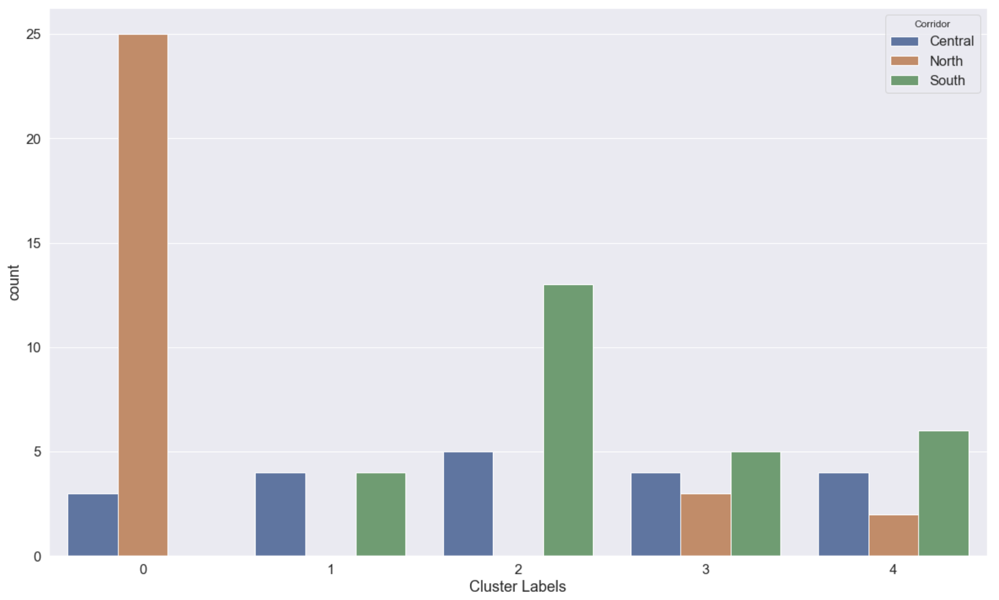
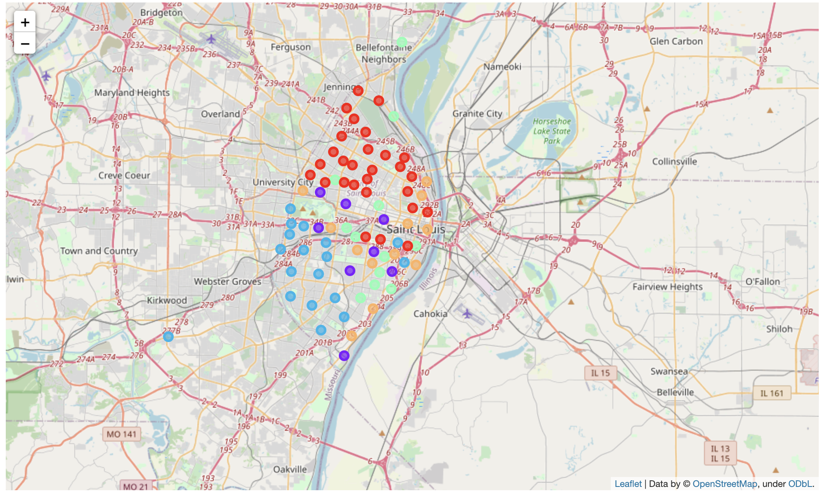
Explore and Analyze
Cluster 0 (red) is predominantly Black and cluster 2 (blue) is predominantly White.
85.27%
93.29%
Black population in predominantly Black neighborhoods
White population in predominantly White neighborhoods

Slide 8
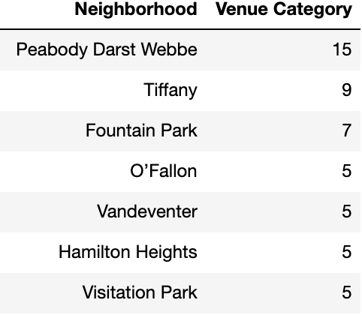
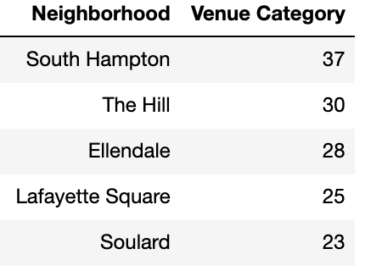
Explore and Analyze
Based on the data it appears that people in Cluster 0 neighborhoods use Foursquare app less frequently compared to people on Cluster 2 neighborhoods.
15
37
Highest number of venue categories in Cluster 0 (Black) neighborhoods
Highest number of venue categories in Cluster 2 (White) neighborhoods

Slide 9
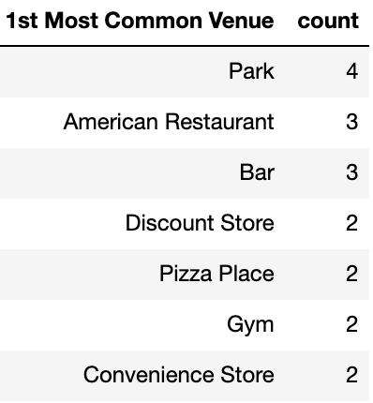
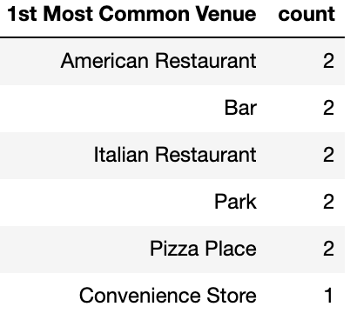
Final Analysis and Remarks
Park appears to be the most common venues for Black neighborhoods followed by American Restaurant and Bar at tie. On the other hand, American Restaurant, Bar, Italian Restaurant and Park are the most common venues in White neighborhoods.

